Slide 1


Outcomes of Operative vs. Non-Operative Treatments for Pelvic and Acetabular Fractures
University of North Carolina at Charlotte
M.S. in Data Science and Business Analytics
DSBA 6400
Jameson Ellis

Slide 2
Introduction
Objective: To utilize predictive analytics to evaluate and compare the outcomes of patients treated operatively versus non-operatively following pelvic and acetabular fractures.
Pelvic and acetabular fractures present significant challenges in treatment, and understanding the outcomes of different treatment approaches is crucial for optimizing patient care.

Slide 3
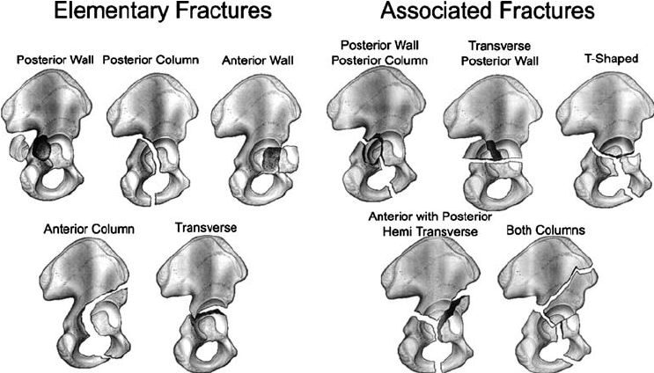
Background and Significance
Pelvic Ring Injuries: Represent approximately 9% of all fractures from blunt trauma.
Challenges: Associated injuries can confound results; limited large, multicenter prospective studies.
Study Goals: Capture data on functional, clinical, and performance outcomes to optimize patient care.

Slide 4

Study Protocol
Data Collection: Performance assessments (TUG, 10mWT) and patient-reported outcomes (PROMIS-29, Majeed Pelvis Score).
Sample Size: 1,000 patients.
Primary Outcomes: Return to work/activities, PROMIS-29 scores.
Secondary Outcomes: Fracture healing, pain, mobilization, complications, cost.

Slide 5

Project Plan Outline
Data Acquisition and Management
Exploratory Data Analysis (EDA)
Predictive Analytics
Model Evaluation
Reporting and Presentation

Slide 6
Data Preparation
Exporting/Importing Data
Initial Cleanup
Investigating Missing Data
Creating Summary Tables
Identifying Unique Patients and Features
Checking Data Consistency

Slide 7
Predictive Analytics
Variables Chosen for the Model:
Gender
Age
Initial Definitive Treatment
Total Injury Severity Score (ISS)
Charleston Comorbidity Index (CCI)
Race
Insurer
Independent Living Status
Fracture Type
Total PROMIS-29 Score
Majeed Score
Complications Since Last Visit
Model Selection: Logistic regression for binary outcomes.
Data Splitting: 80-20 split for training and testing sets.
Model Training: Logistic regression model built and trained using training data.
Notes:
Baseline Data: Only baseline data was used for the analysis due to the initial scope and time constraints of the project. This approach allowed for a focused evaluation of the immediate post-treatment outcomes without the complexity of longitudinal data.
Target Variable: The "complications since last visit" variable was used as the target variable because it directly measures the occurrence of complications, providing a clear and relevant outcome for predictive modeling. This aligns with the project's objective to compare the effectiveness of operative versus non-operative treatments in terms of patient complications.

Slide 8
Model Evaluation
Evaluation Metrics:
Accuracy: 0.7731
Precision: 0.5904
Recall: 0.3485
F1 Score: 0.3193
ROC AUC Score: 0.5886

Slide 9
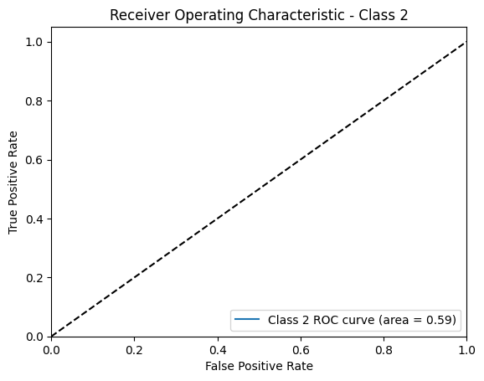
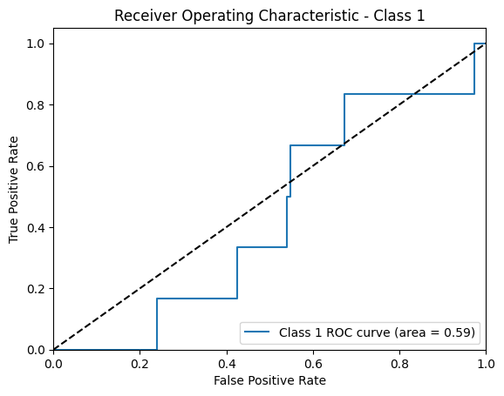
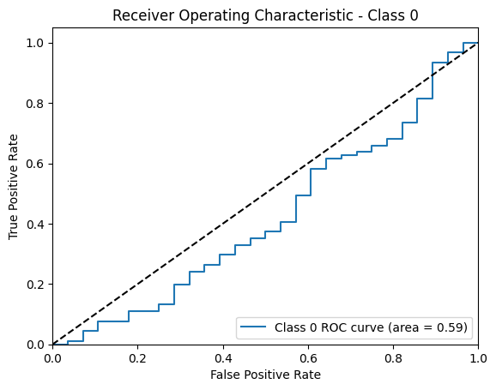
Visualizations:

Slide 10
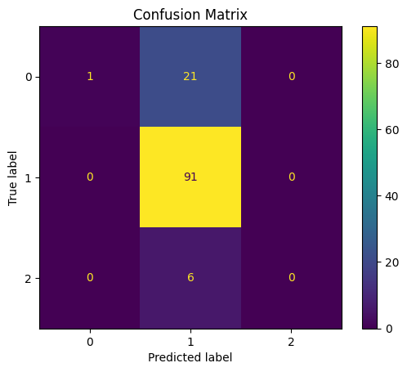
Confusion Matrix

Slide 11
Coefficients Interpretation
Females and older patients are less likely to experience complications.
Higher injury severity and comorbidity scores increase complication risks.
Multi-race and white races, and private insurance types reduce complication likelihood.
Independent living decreases the likelihood of complications.
Higher PROMIS-29 and Majeed scores increase the likelihood of complications.

Slide 12
Key Findings and Implications
Operative vs. Non-Operative Treatments: Operative treatments have higher complication risks.
Key Factors: Age, sex, ISS score, CCI score, race, insurer, independent living status, fracture type, PROMIS-29 score, and Majeed score influence complications.
Clinical Implications: Tailoring treatment plans to individual profiles can reduce complications.
Impact on Patient Care: Understanding predictors helps improve recovery and reduce adverse outcomes.

Slide 13
Model Improvements
Potential Improvements and Future Work:
Baseline Data: Include repeat analyses at multiple intervals to capture longitudinal trends.
Random Forest Model: Identify key predictors, handle non-linearity, and reduce overfitting.
Additional Models: Explore other machine learning models for better accuracy and robustness.
Evaluation Metrics: Current metrics are not great due to potential issues with the dataset.
Future Work: Determine complication rate and account for missing cases by checking the "final status form."

Slide 14

Questions and Comments

Slide 15
Acknowledgements
Data Team: Special thanks to my mentor, Dr. Susan Odum, and her team for their invaluable guidance and support throughout this project.
MSKI Department: Appreciation to the MSKI department for allowing me to use their resources and facilities.
UNC Charlotte: Heartfelt thanks to all my professors and the faculty and staff in the M.S. in Data Science and Business Analytics program at UNC Charlotte for their continuous support and encouragement.

